Slide 1
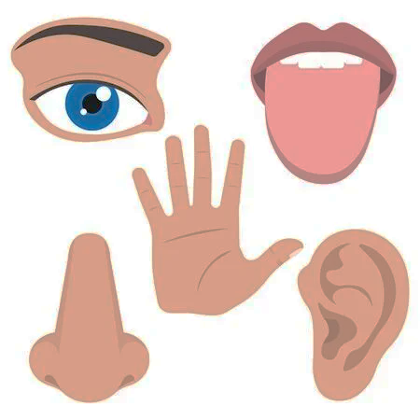
Do Now
Without getting out of your chair, quietly write in your notebook:
5 things that you can see
4 things that you can hear
3 things that you can feel
2 things that you can smell
1 thing that you can taste

Slide 2
Observing and Inferring
Success Criteria
I can:
make scientific observations
describe the difference between observations and inferences

Slide 3
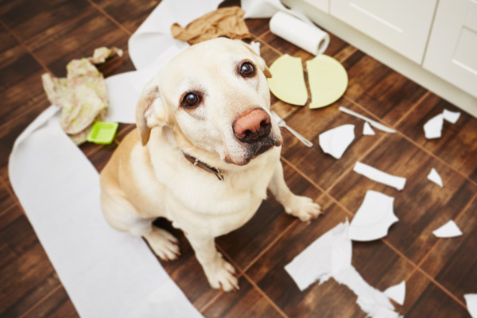
Observations
Use as much detail as you can.
With your partner, describe what is happening in this picture.

Slide 4
Observations
Observations are pieces of information that we get directly from our senses – sight, hearing, touch, smell and taste.
Notes:
We don’t know whether the dog created the mess.
I observe that there is a yellow dog on a brown floor, surrounded by a mess.

Slide 5
Observations
Observations are pieces of information that we get directly from our senses – sight, hearing, touch, smell and taste.
Notes:
We don’t know whether the dog created the mess.
I observe that there is a yellow dog on a brown floor, surrounded by a mess.
What else do you observe?

Slide 6
Inferences
Inferences are ideas that we come up with to explain our observations. Inferences are not necessarily correct. There can be more than one inference.
One inference here is that the dog created the mess.
Question
What are some other inferences that you can make?
Notes:
One inference is that the dog created the mess.

Slide 7
Definitions
Observation (noun): a piece of information that you get from your senses.
My observation is that there is graffiti on the table.
Observe (verb): to notice something with your senses.
In Science, we normally observe with our eyes, nose, hands, and ears.
Notes:
One inference is that the dog created the mess.

Slide 8
Definitions
Inference (noun): an explanation or reason to explain an observation.
My observation is there is graffiti on the table. My inference is that a student drew on the table.
Infer (verb): to explain an observation
Because this bread is green, I infer that it is mouldy.
Notes:
One inference is that the dog created the mess.

